Slide 1

The Mandela Effect
Overview by John Kirwin
Wakeuporelse.com
Wakeuporelse (Youtube)
2 Timothy 3:1 ”But know this, that in the last days perilous times will come”

Slide 2
Prov 18:13
He who answers a matter before he hears it,
It is folly and shame to him.

Slide 3
The problem
There is a phenomena taking place right now that is going almost entirely unnoticed by the body of Christ.
This event is extremely perilous to the souls of men especially the church.
And it was clearly prophesied in the old and new testaments giving us fair warning so we would not be deceived. Its validity does not violate the orthodox teachings of the scripture in any way.
We have found that although this phenomena appears to be very obvious to us….it seems somehow to be hidden from most of the people that we try to show it to
We believe that there are six primary reasons why people are unable or unwilling to concede that this is happening

Slide 4
Why people are unable or unwilling to conceded that this is happening
Unwillingness to be persecuted – Pastors do not want to be labeled a conspiracy theorist and this issue may fall into that category for many people…but I can assure you…that it is not.
Naturalistic world view and false concepts regarding the nature of reality
False concept of the doctrine of the preservation of scripture
Fales concept of free will, Satan’s powers and permissions in the last days and what God will allow
Unwillingness to admit that you have been deceived about almost everything your entire life (Except orthodox Christian teachings of course)
Lack of unconditional commitment to the truth which then makes individuals susceptible to highly advance technology or witchcraft that we clearly see being used to influence thought Causing the 2 Thessalonians 2 Strong delusion.

Slide 5
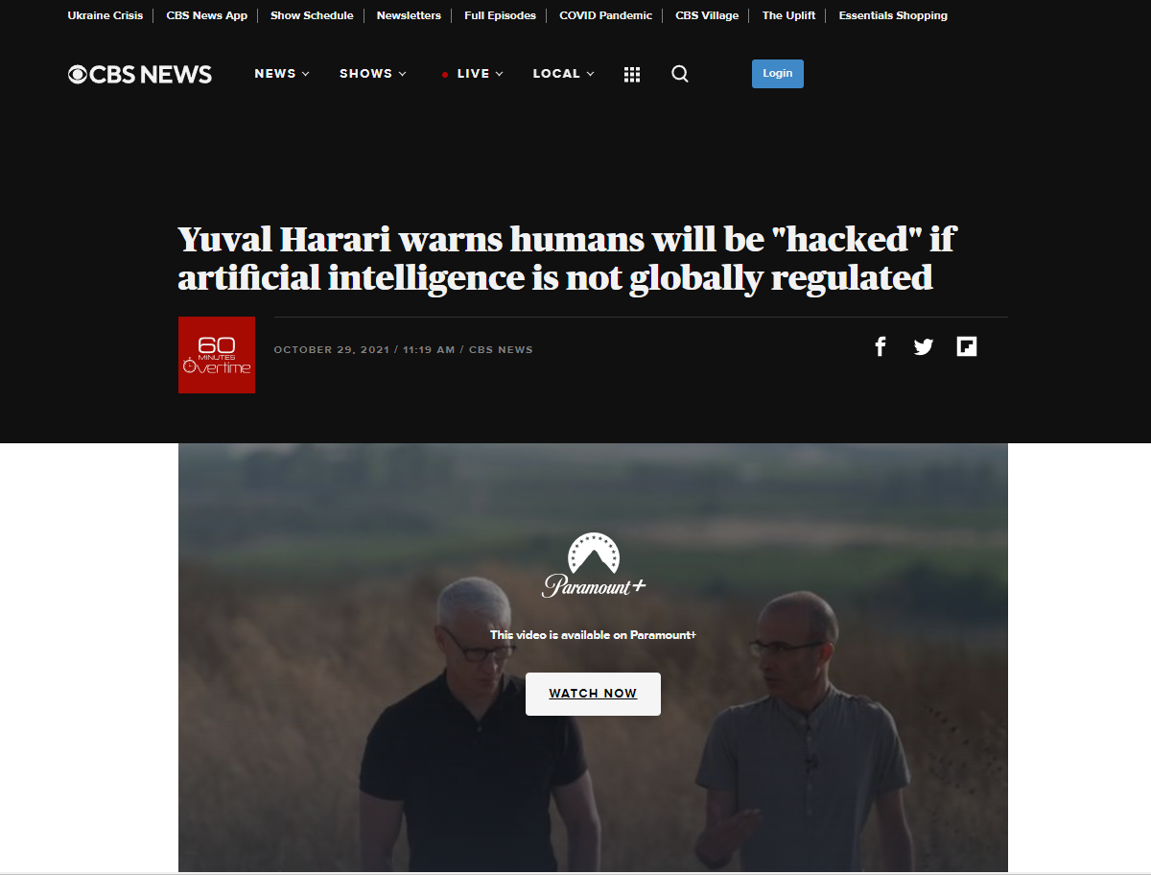
Do you think that mind control weapons are just a conspiracy theory?
Similarly, the combination of AI and biotechnology means that we are very close to the point when you can hack human beings.
There’s a lot of talk about hacking computers, emails and bank accounts. But we are entering an era of hacking humans. And I’d say the most important fact anybody who is alive today needs to know about the 21 century is that we are becoming hackable animals.

Slide 6
What is the Mandela Effect?
Its not one person vividly remembering one thing that no longer exists. It is;
Many people vividly remembering many things across many categories
However, what people are very emphatically asserting is that the things that they are vividly remembering have never existed the way they vividly remember them. Vividly like your name, the color of grass or the color of the sky. These are not things that can just be brushed aside by the idea that we are just misremembering. The reaction that people generally have to this experience is unbridled astonishment. Not a quirky misremembering.

Slide 7
What is the Mandela Effect?
Those claiming this experience will say with 100% certainty that;
They have never experienced anything like this before
That in many cases it is turning their lives upside down, causing divorce, church splits and isolation
They have experienced misremembering and this is not that
They're high certainty level across so many different examples has placed them in a position where the unconvinced will be forced to produce a different argument than misremembering if they are to be persuaded.
This clearly appears to be a phenomenon

Slide 8
Warning
We believe your susceptibility to these influences are directly proportional to your commitment to the truth no matter where it takes you. No matter what the cost because according to the dictionary…..truth are things that are factual. And facts are things that are obvious.
I'm not saying you have to agree with me today….but…..if I show you things that are obvious and you refuse to even consider them, then you are displaying the dictionary definition of delusional.

Slide 9
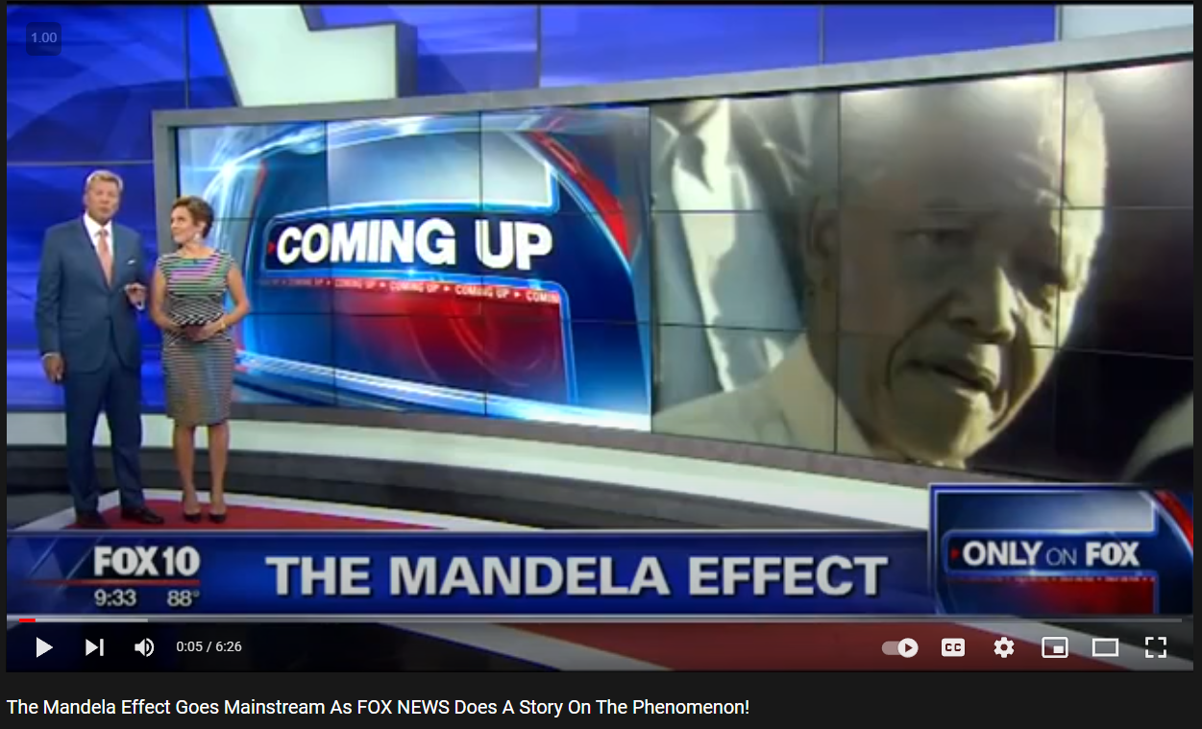
Fox News covers the Mandela Effect

Slide 10
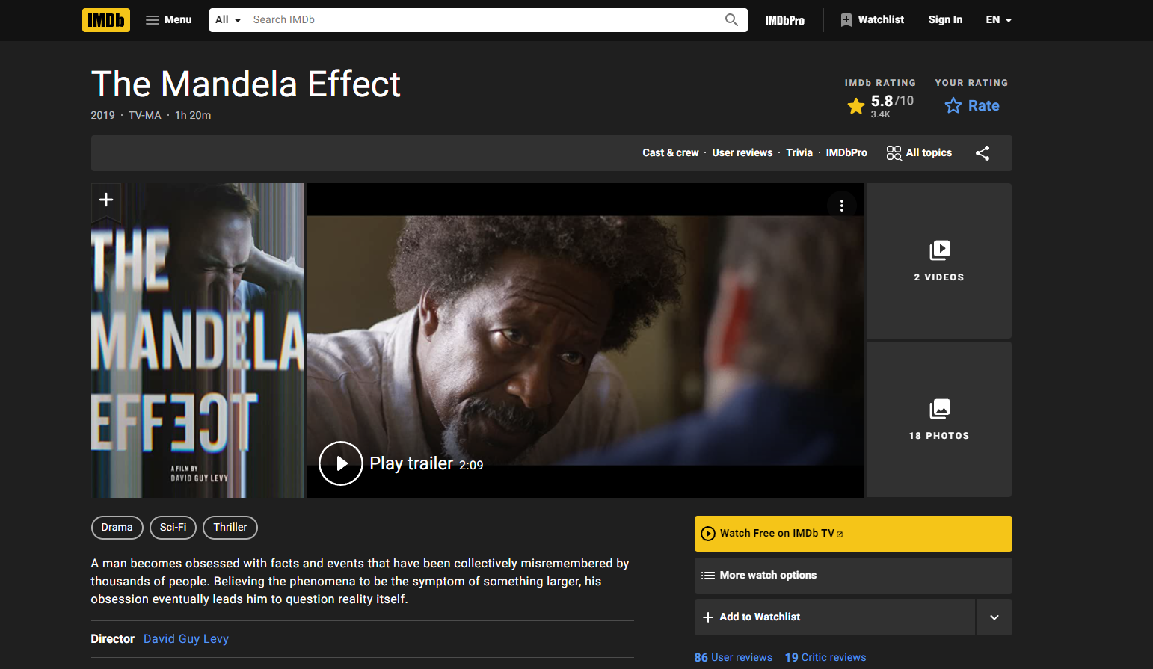
New Movie

Slide 11
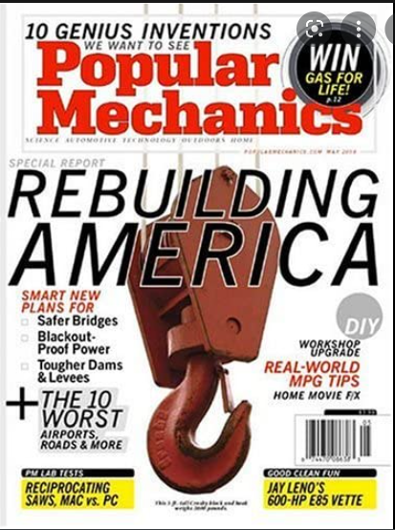
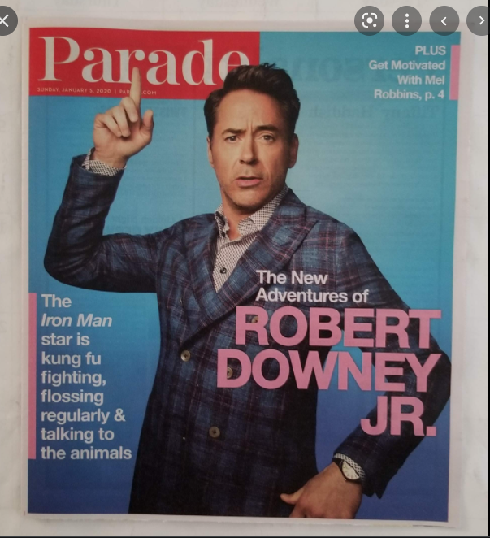
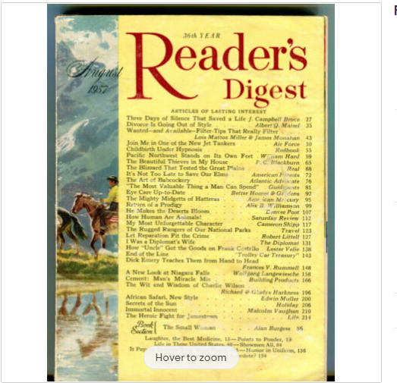

National Publications producing articles and Mandela Effect quizzes.

Slide 12
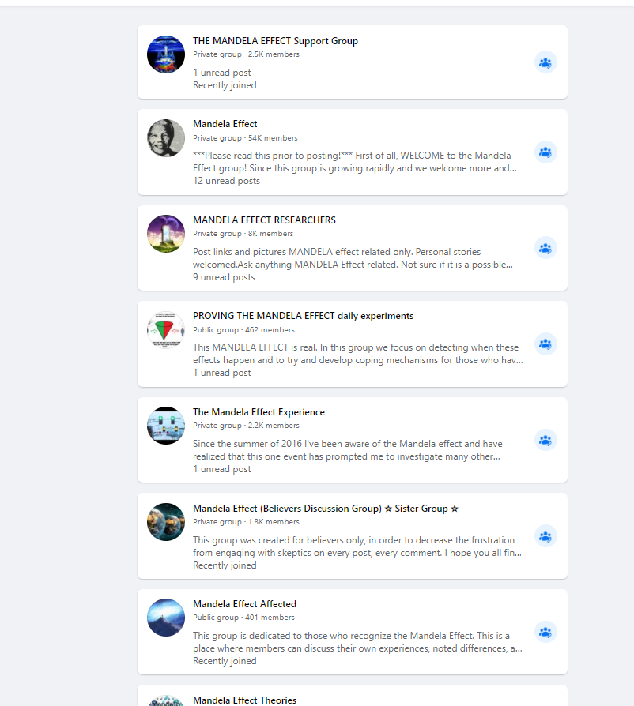
Why are there over
100 Mandela Effect
Groups on Facebook?

Slide 13
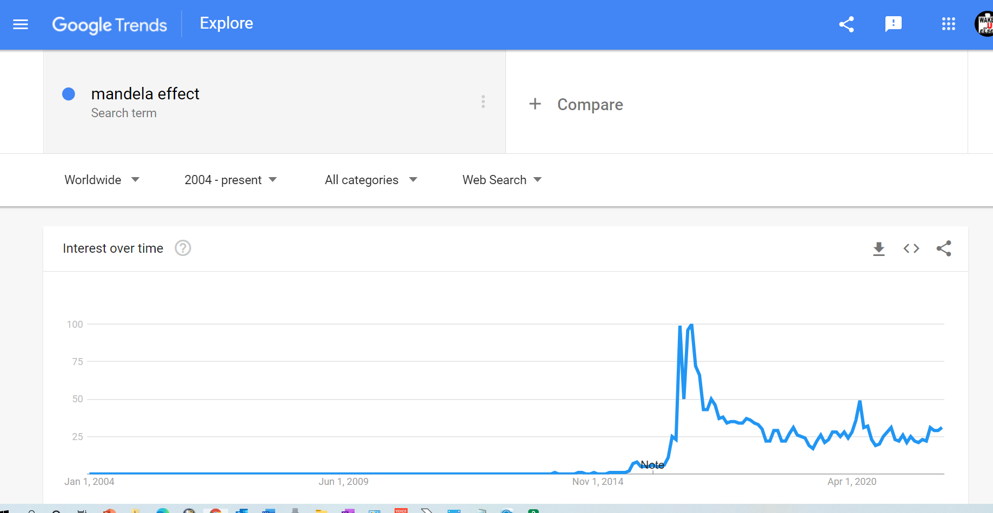
Google Trends

Slide 14
Example # 1 of what its like to experience the Mandela Effect
What is the name of the street that you grew up on?
How certain are you that you are correct?
In your mind…..is it possible that you are mistaken?
How would you feel if the following three things happened starting tomorrow
You woke up and found out the name of the street had changed and it had always been that way. All sources prove it was always different from what you remember….accept
You were able to find an old year book picture with you in front of the street sign and it was the way that you remember it
Everyone was trying to tell you that you were just misremembering but when you ask them to explain the picture they don’t have an answer.
How would that make you feel?

Slide 15
Example # 2 of what its like to experience the Mandela Effect
You wake up one morning and the 1st letter of your name has changed. All of your documents confirm the change. You also find out that the bank that you thought you had an account with for the last 15 years is different. How could all of those transactions be faked. That is a record of your life…but there it is. Lastly, the first letter of your spouse’s name has changed and they swear its always been that way and they are telling you that you are just misremembering.
How would you feel and what conclusion would you draw?

Slide 16
What its like (continued)
Now imagine that this same experience is repeated hundreds of times in multiple categories including;
Famous people's names
Famous Places
Famous Movie quotes
The names of movies, TV shows and the names of books
Spelling of words
Events in history
Company logos
Geography
Human anatomy
And yes……! Even the Bible, the Concordance and the commentaries

Slide 17
What its like (continued)
Now imagine that you are able to find these additional proofs to verify that you are not crazy and that something unexplainable is happening
There is residual evidence for almost every memory that you have that no one has an explanation for (ie Lion & Lamb residual)
There are 100s of thousands and possibly millions of other people also claiming this same experience. One they have never had before
Some of the things that you noticed are changed but then they changed back in a short period of time (Flip flop) and its not just on the internet…its also in the real world so its not photoshopped tricks or a government phsyop.
You went to the bible and found that this event is clearly foretold in several places
In this hypothetical example…..if you were to discover these things that seem to support your belief that something strange is happening …. What conclusion would you draw?

Slide 18
Understanding the exotic nature of the phenomena (Example)
You vividly remember the Lion laid down with the lamb
You are told that the Mandela effect is real
You go to your bible and see that it says wolf and you are surprised
You are told that it has been changed supernaturally
You say “When did it change? Was it 10 years ago?
  Ie From Dead sea scrolls to 2012 it said Lion…then anytime after that it said wolf.
We say “no….the change is more all encompassing then that…..even though you have lived and experienced it as lion…..it has never been lion where ever you or your consciousness is now…..it has always said wolf all the way back to the dead sea scrolls.”
Conclusion: The change in the bible includes the time line not just the book, your physical history, the existence that you have experienced has either shifted, your consciousness has shifted or history (Spacetime) has been rewritten.

Slide 19
Biblical Examples Of Phenomenon

Slide 20
Wormholes, portals, dimensional openings Psalms 18
Then the earth shook and trembled;
The foundations of the hills also quaked and were shaken,
Because He was angry.
Smoke went up from His nostrils,
And devouring fire from His mouth;
Coals were kindled by it.
9 He bowed the heavens also, and came down
With darkness under His feet.
10 And He rode upon a cherub, and flew;
He flew upon the wings of the wind.
11 He made darkness His secret place;
His canopy around Him was dark waters
And thick clouds of the skies.
From the brightness before Him,
His thick clouds passed with hailstones and coals of fire.

Slide 21
Wormholes, portals, dimensional openings
Gen 28:10
Now Jacob went out from Beersheba and went toward Haran. 11So he came to a certain place and stayed there all night, because the sun had set. And he took one of the stones of that place and put it at his head, and he lay down in that place to sleep. 12Then he dreamed, and behold, a ladder was set up on the earth, and its top reached to heaven; and there the angels of God were ascending and descending on it.
13And behold, the Lord stood above it and said: “I am the Lord God of Abraham your father and the God of Isaac; the land on which you lie I will give to you and your descendants.
Vs 17 And he was afraid and said, “How awesome is this place! This is none other than the house of God, and this is the gate of heaven!”

Slide 22
Wormholes, portals, dimensional openings
Rev 17:8
“The beast that you saw was, and is not, and is about to come up out of the abyss and go to destruction. And those who dwell on the earth, whose name has not been written in the book of life from the foundation of the world, will wonder when they see the beast, that he was and is not and will come.

Slide 23
Biblical examples of time distortion
Isaiah 38:8 I will cause the sun’s shadow to move ten steps backward on the sundial of Ahaz!’” So the shadow on the sundial moved backward ten steps.

Slide 24
Biblical examples of time distortion
Joshua 10:12
On the day the LORD gave the Israelites victory over the Amorites, Joshua prayed to the LORD in front of all the people of Israel. He said,
“Let the sun stand still over Gibeon, and the moon over the valley of Aijalon.”
So the sun stood still and the moon stayed in place until the nation of Israel had defeated its enemies.
Is this event not recorded in The Book of Jashar? The sun stayed in the middle of the sky, and it did not set as on a normal day. There has never been a day like this one before or since, when the LORD answered such a prayer. Surely the LORD fought for Israel that day!
Chap 88 in Book of Jasher

Slide 25
Dominion over time, space and matter
John 6:19 So when they had rowed about three or four miles, they saw Jesus walking on the sea and drawing near the boat; and they were afraid. But He said to them, “It is I; do not be afraid.” Then they willingly received Him into the boat, and immediately the boat was at the land where they were going.
.

Slide 26
Dominion over time, space and matter
Acts 8:39 Now when they came up out of the water, the Spirit of the Lord caught Philip away, so that the eunuch saw him no more; and he went on his way rejoicing. But Philip was found at Azotus.
John 2:9 When the master of the feast had tasted the water that was made wine, and did not know where it came from (but the servants who had drawn the water knew), the master of the feast called the bridegroom. And he said to him, “Every man at the beginning sets out the good wine, and when the guests have well drunk, then the inferior. You have kept the good wine until now!”
Matthew 14:18 And He took the five loaves and the two fish, and looking up to heaven, He blessed and broke and gave the loaves to the disciples; and the disciples gave to the multitudes. So they all ate and were filled, and they took up twelve baskets full of the fragments that remained.

Slide 27
The devils ability to alter material things
But Pharaoh also called the wise men and the sorcerers; so the magicians of Egypt, they also did in like manner with their enchantments. For every man threw down his rod, and they became serpents.

Slide 28
Devil has control over the elements
Job 1:16 & 18
Job 1:16 While he was still speaking, another also came and said, “The fire of God fell from heaven and burned up the sheep and the servants, and [n]consumed them; and I alone have escaped to tell you!”
Rev 13:13 He performs great signs, so that he even makes fire come down out of heaven to the earth in the presence of men. And he deceives those who dwell on the earth because of the signs which it was given him to perform
Job 1:18 While he was still speaking, another also came and said, “Your sons and daughters were eating and drinking wine in their oldest brother’s house, 19and suddenly a great wind came from [o]across the wilderness and struck the four corners of the house, and it fell on the young people, and they are dead; and I alone have escaped to tell you!”

Slide 29
What is the Mandela Effect?
Definition of phenomenon. .
a fact or situation that is observed to exist whose cause or explanation is in question. (ie a mystery)
If you properly understand all the facts of this phenomenon, I believe that you will be forced to concede as we have that there is no reasonable explanation for this.

Slide 30
Main arguments against the Mandela Effect
Mis-remembering
  The memory cant be trusted
  Mind tricks like confabulation / implanted thoughts
Crazy, delusional, mental instability
  Unconvinced remember the same things do but come to a different concusion
2nd Thes strong delusion (Gods Judgment)
  This is the direct result of willful ignorance
False prophets, Heretics, Charlatans, wolves in sheep's clothing
  This implies premeditation….malice…purposeful deception

Slide 31
Main arguments against Mandela Effect
Demonic deception
  This is possible but it’s a reductionist explanation….ie how is it happening?
Government psyop
  Photoshopped tricks
Biblical illiteracy
  Translation confusion
  Original texts vs modernizations
  Doctrine of immutability of scripture – we agree that God does not change
Confusing normal logo changes by companies as the ME

Slide 32
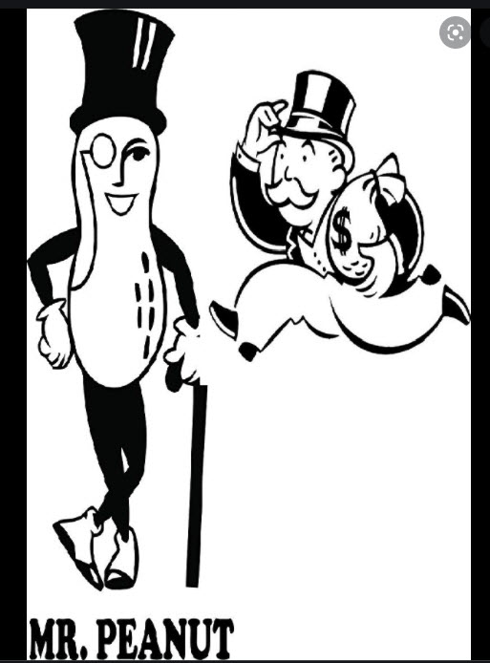
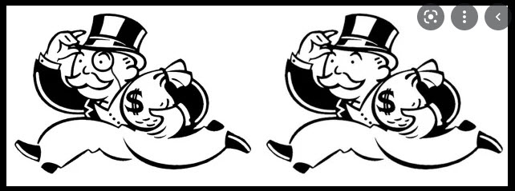
Implanted thought theory

Slide 33
Not just relying on our memories
Biblical prophecy (Nothing to do with memory)
Residual evidence (Nothing to do with memory)
Statistical probabilities (Nothing to do with memory)
Flip flops (Nothing to do with memory)
Notable figures agree (Nothing to do with memory)
Vivid memories (Admissible in court)
Shared experiences (Your having the same memories)

Slide 34
18 U.S. Code § 3502.
Admissibility in evidence of eye witness testimony
“The testimony of a witness that he saw the accused commit or participate in the commission of the crime for which the accused is being tried shall be admissible in evidence in a criminal prosecution in any trial court ordained and established under article III of the Constitution of the United States.”

Slide 35
According to PMC
US National Library of Medicine
“This distinction between the perception and reality of memory has important consequences in the context of the courtroom. In the legal system, like among the general public, it is generally assumed that memory is highly accurate and largely indelible, at least in the case of 'strong' memories.”
The US Library of medicine disagrees with you

Slide 36
Long Term Memory Study
Results of the study showed that participants who were tested within 15 years of graduation were about 90% accurate in identifying names and faces. After 48 years they were accurate 80% for verbal and 70% visual.
www.simplypsychology.org › long-term-memory
By Saul McLeod, published 2010

Slide 37
Mis-remembering
Definition of remembering
To remember is to bring to mind an awareness
It is to recall to the Mind by an act of memory
Thinking is a process
There are four categories of remembering
Can’t remember
Trying to remember
Remember
Mis-remember

Slide 38
God wouldn’t tell me to do something
I couldn’t do!
Deuteronomy 8:18 But you shall remember the Lord your God, for it is He who is giving you power to make wealth, that He may confirm His covenant which He swore to your fathers, as it is this day.Source: https://bible.knowing-jesus.com/topics/Remembering
1 Chronicles 16:12 Remember His wonderful deeds which He has done,His marvels and the judgments from His mouth,Source: https://bible.knowing-jesus.com/topics/Remembering
Deuteronomy 9:7-8 Remember, do not forget how you provoked the Lord your God to wrath in the wilderness; from the day that you left the land of Egypt until you arrived at this place, you have been rebellious against the Lord. Even at Horeb you provoked the Lord to wrath, and the Lord was so angry with you that He would have destroyed you.Source: https://bible.knowing-jesus.com/topics/Remembering

Slide 39
Preservation of scripture
Inspiration of scripture
Immutability
Inerrancy
Accuracy
The cannon
Original manuscripts vs Vatican
Different translations

Slide 40
Don Stewart –http://www.educatingourworld.com/
“Those who argue against the Bible teaching the providential preservation of Scripture make the distinction between the divine inspiration of Scripture and its providential preservation. They claim that there is nothing in the doctrine of the divine inspiration which necessitates that the Scriptures be providentially preserved. They further claim that the scriptures that are used to teach the bible can’t be changed have either been misunderstood or misused.”
Don Stewart has written over twenty books on the subject of evidences for the Christian faith.

Slide 41
Scriptures used to teach the Bible can’t be changed
Tisaiah 40:8 The grass withers, the flower fades; but the word of our God will stand for ever.
Mattew 5:18 For truly I tell you, until heaven and earth disappear, not the smallest letter, not the least stroke of a pen, will by any means disappear from the Law until everything is accomplished.
  Vs 17 “Do not think that I have come to abolish the Law or the Prophets; I have not come to abolish them but to fulfill them.

Slide 42
God protected his word…. ”until”
But thou, O Daniel, shut up the words, and seal the book, even to the time of the end: many shall run to and fro, and knowledge shall be increased.
– Daniel 12:4
And he said, Go thy way, Daniel: for the words are closed up and sealed till the time of the end.
– Daniel 12:9

Slide 43
Protection has been lifted (Revelations 22:10)
And he sayeth unto me, Seal not the sayings of the prophecy of this book: for the time is at hand.
– Revelations 22:10
  Strongs # G4972
  to set a seal upon, mark with a seal, to seal…. for security: from Satan
  to stamp (with a signet or private mark) for security or preservation

Slide 44
Revelations 22:18-19
For I testify to everyone who hears the words of the prophecy of this book: If anyone adds to these things, God will add to him the plagues that are written in this book;

Slide 45
Dan 7:25
And he shall speak great words against the most High, and shall wear out the saints of the most High, and think to change times and laws: and they shall be given into his hand until a time and times and the dividing of time.

Slide 46
Dan 7:25
In Dan 7:25 the word law is the word “dath” The KJV translates Strong's H1882 in the following manner: law (11x), decree (3x).
In the Hebrew Chaldee Lexicon one of the meanings of the word actually is “The law of God”.

Slide 47
Dan 7:25
Therefore….Dan 7:25 could be interpreted as follows:
And he shall speak great words against the most High, and shall wear out the saints of the most High, and think to change the space/time continuum and the bible: and they shall be given into his hand until a time and times and the dividing of time.

Slide 48
Amos 8:11
The days cometh, sayeth the Lord, that I will send a famine in the land. Not a famine of bread nor a thirst for water, but of hearing the words of the Lord.
– Amos 8:11
And they shall wander from sea to sea, and from the north even to the east, they shall run to and fro to seek the word of the LORD, and shall not find it.
– Amos 8:12

Slide 49
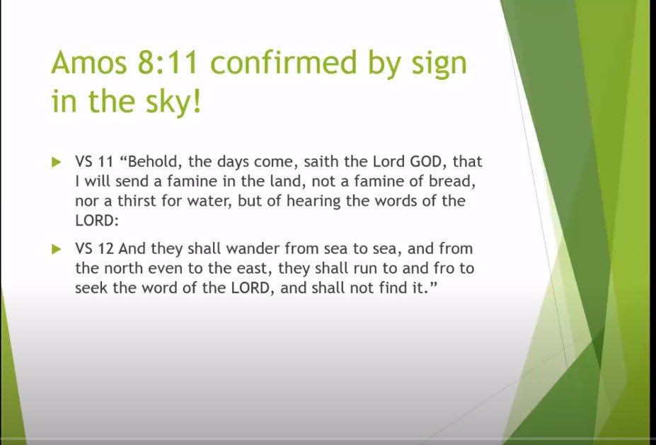
Details on Amos 8 prophecy

Slide 50
Enoch described the Mandela Effect (Chap 80)
And in the days of the sinners the years shall be shortened, And their seed shall be tardy on their lands and fields, And all things on the earth shall alter, And shall not appear in their time: And the rain shall be kept back and the heaven shall withhold it. And in those times the fruits of the earth shall be backward.

Slide 51
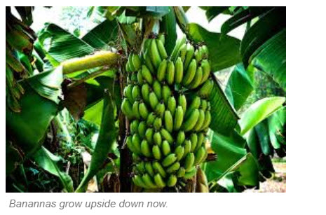
Enoch called this one

Slide 52
God will allow it
And it was given unto him to make war with the saints, and to overcome them: and power was given over all kindreds, and tongues, and nations.
– Revelations 13:7
And he doeth great wonders, so that he maketh fire come down from heaven on the earth in the sight of men.
– Revelations 13:13

Slide 53
“I don’t believe the Devil has that much power!”
Even him, whose coming is after the working of Satan with all power and signs and lying wonders, (This was originally lying signs and wonders)
–2nd Thessalonians 2:9
And with all deceivableness of unrighteousness in them that perish: because they received not the love of the truth, that they might be saved.
– 2nd Thessalonians 2:10
And they worshipped the dragon which gave power unto the beast: and they worshipped the beast, saying, Who is like unto the beast? who is able to make war with him? Rev 13:4

Slide 54
This is the reality of many Conspiracy Theorists
Hebrews 11:35 Others were tortured, not accepting deliverance, that they might obtain a better resurrection. Still others had trial of mockings and scourgings, yes, and of chains and imprisonment. They were stoned, they were sawn in two, were tempted, were slain with the sword. They wandered about in sheepskins and goatskins, being destitute, afflicted, tormented— of whom the world was not worthy. They wandered in deserts and mountains, in dens and caves of the earth.

Slide 55
Mandela Effect examples
Forrest Gump – “Life ________ like a box of chocolates”
Snow White - __________ ________ on the wall who’s the fairest of them all?
Mt Rogers - It’s a beautiful day in _______ neighborhood
Student study guides - Cli……_______ notes
Grand Central _________
Witch in wizard of OZ _________
You’re (We’re) going to need a bigger boat
Lucy you have some “splainin” to do
This is another fine mess you’ve gottus into
Bean me up Scotty
________ I am your father

Slide 56

Which one seems correct?

Slide 57
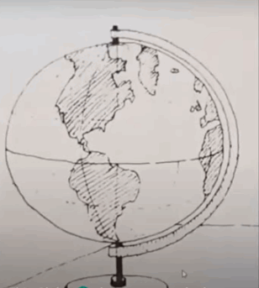


Slide 58
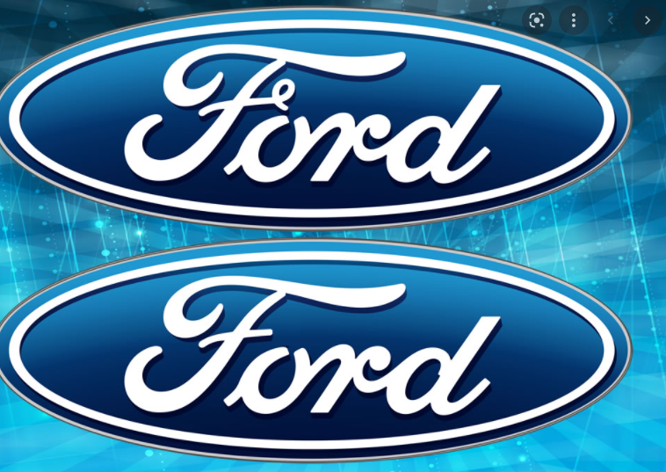
Which one seems correct?

Slide 59
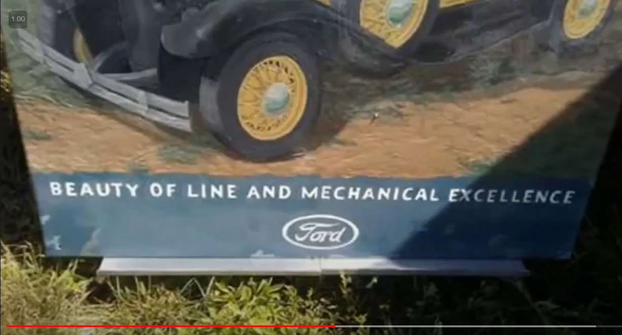

Slide 60
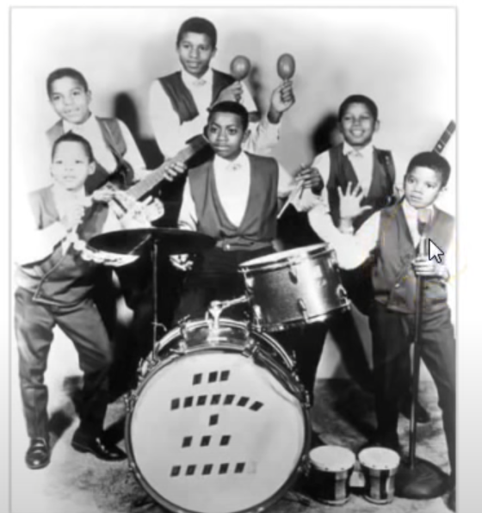
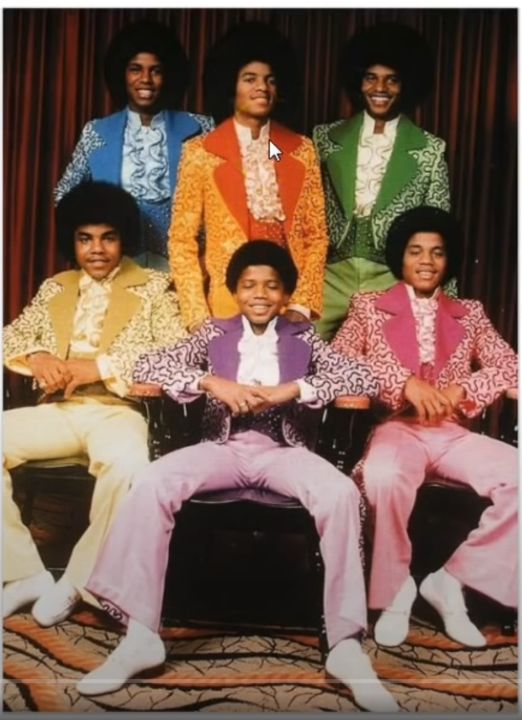
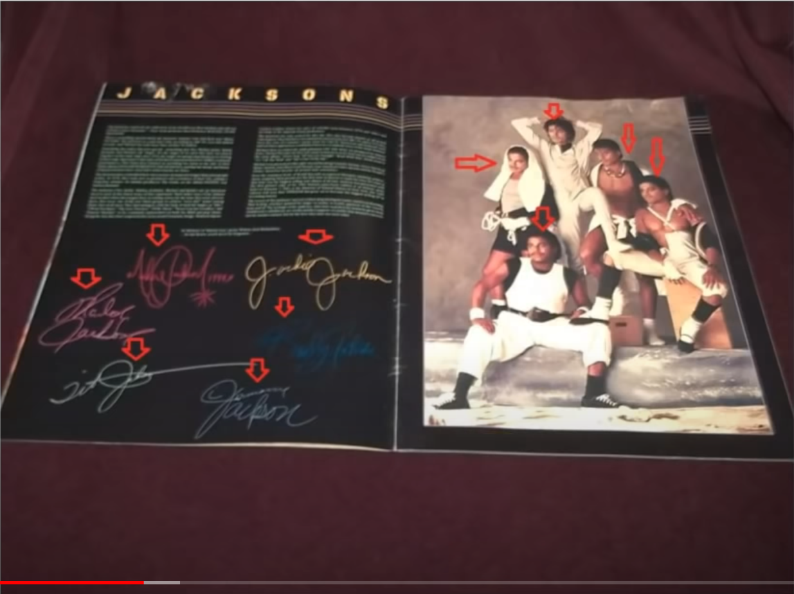
How many in the Jackson 5?

Slide 61
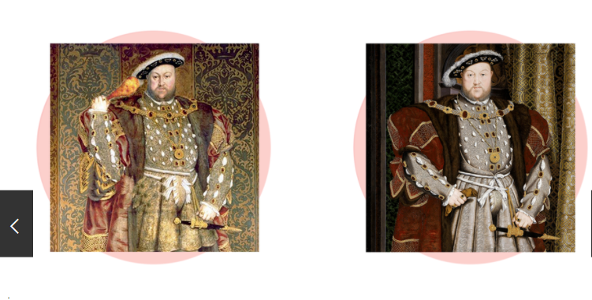
King Henry The 8th

Slide 62

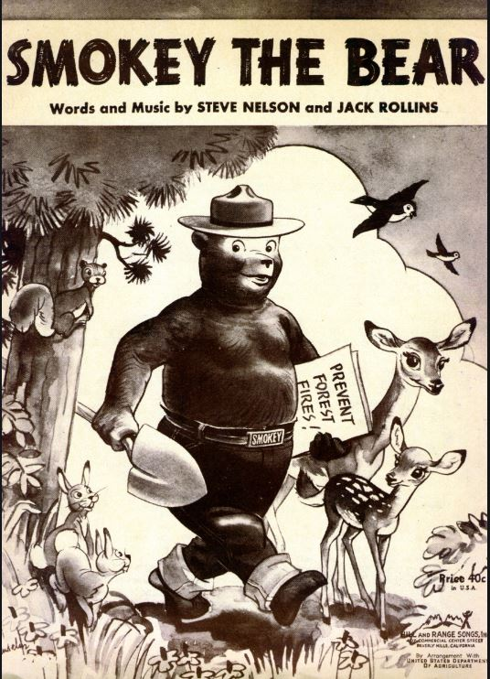
Which one seems correct?

Slide 63
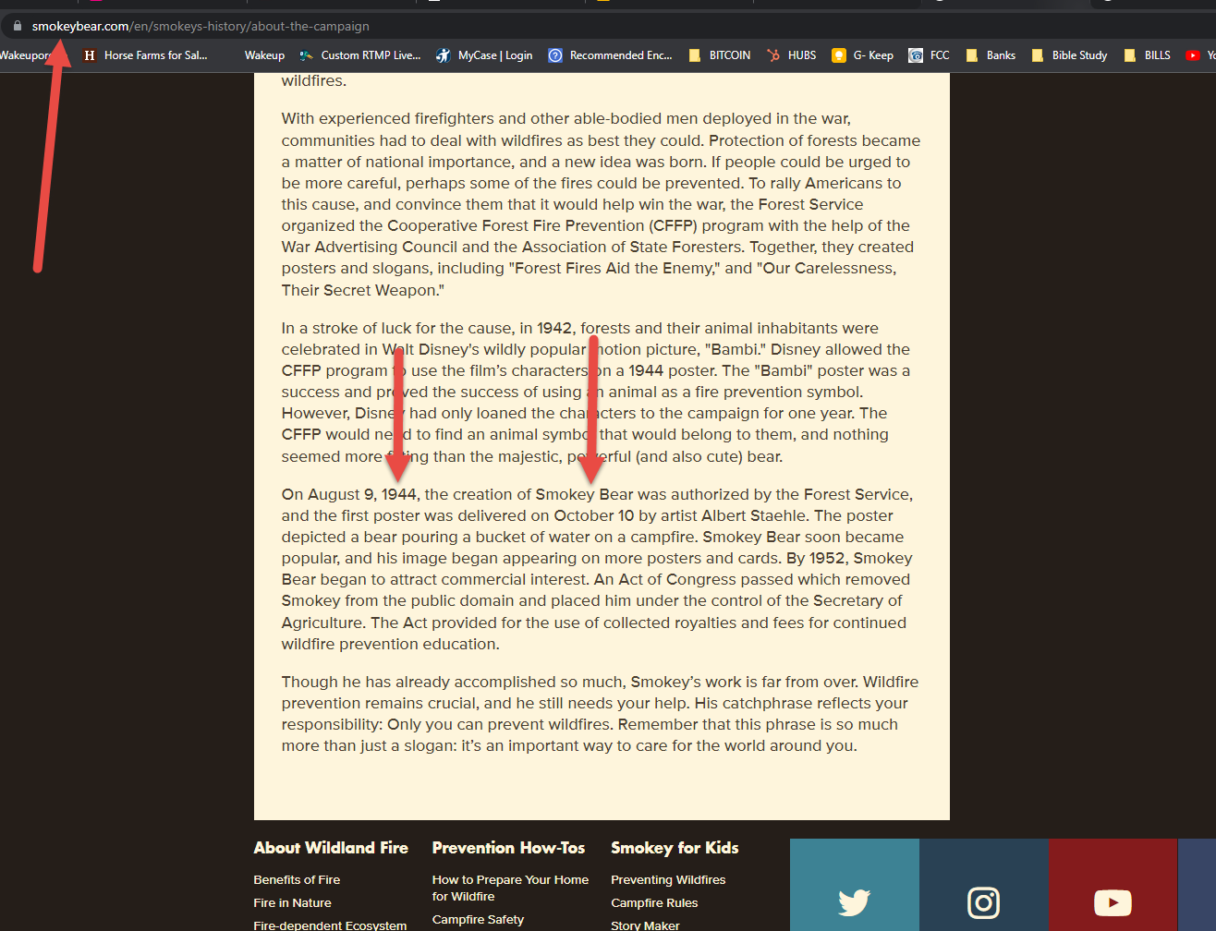

Slide 64
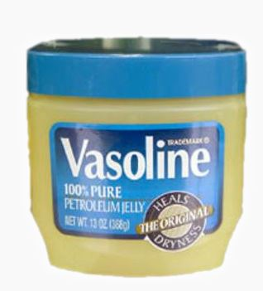
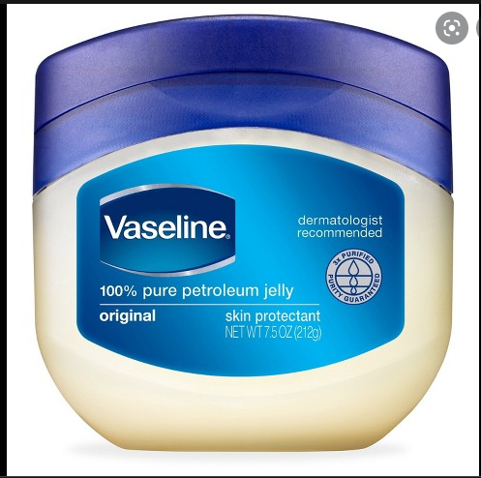
Which one seems correct?

Slide 65
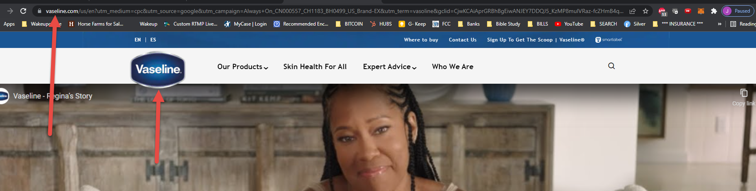
Name has always been Vaseline

Slide 66
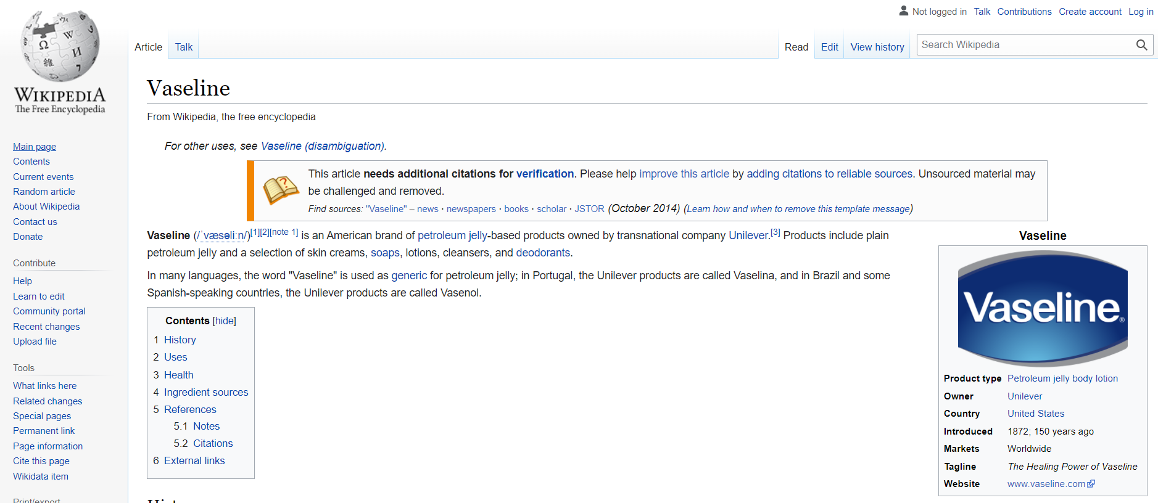

Slide 67
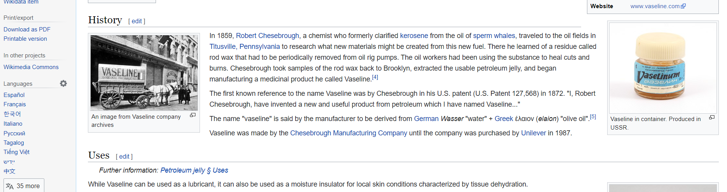
Vaseline patent 1872

Slide 68
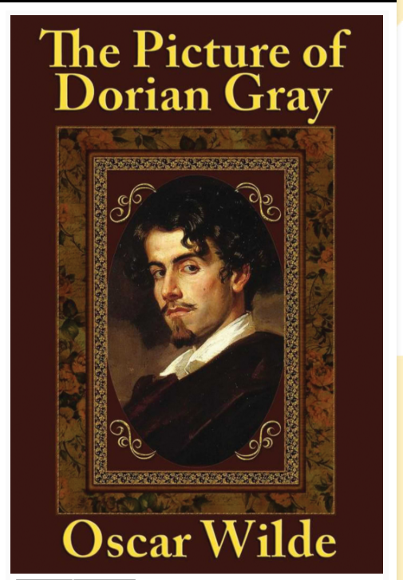
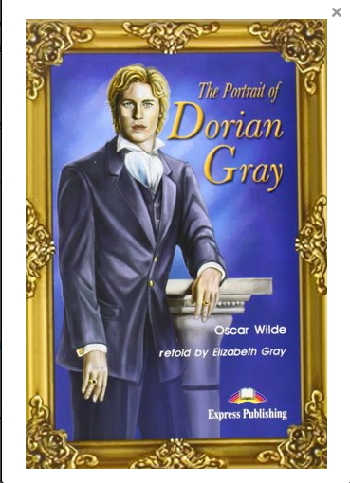
Portrait or Picture of Dorian Grey?

Slide 69
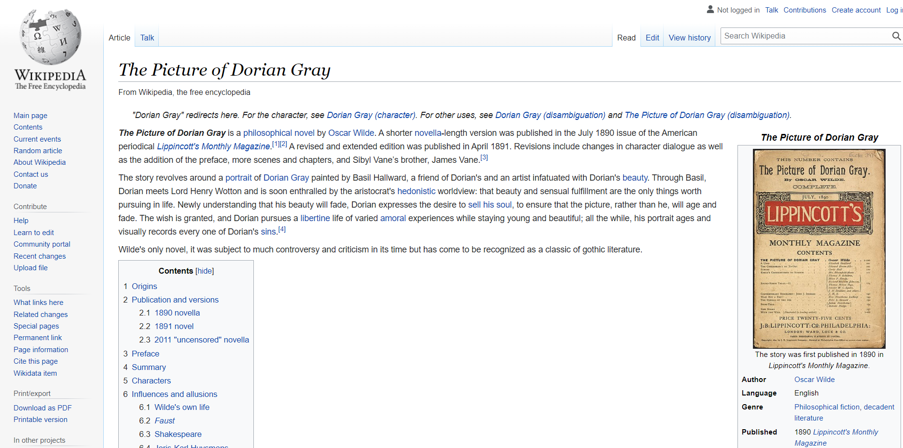

Slide 70
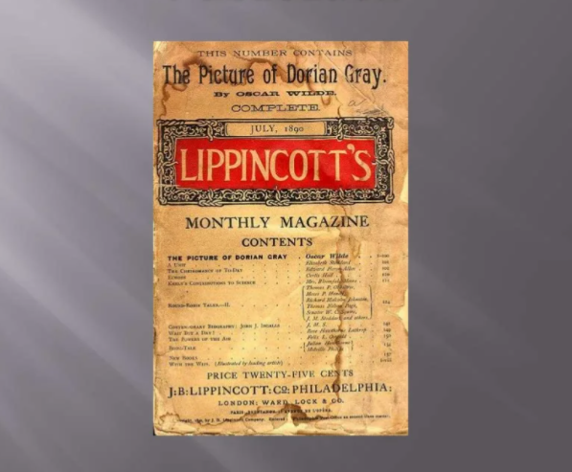

Slide 71
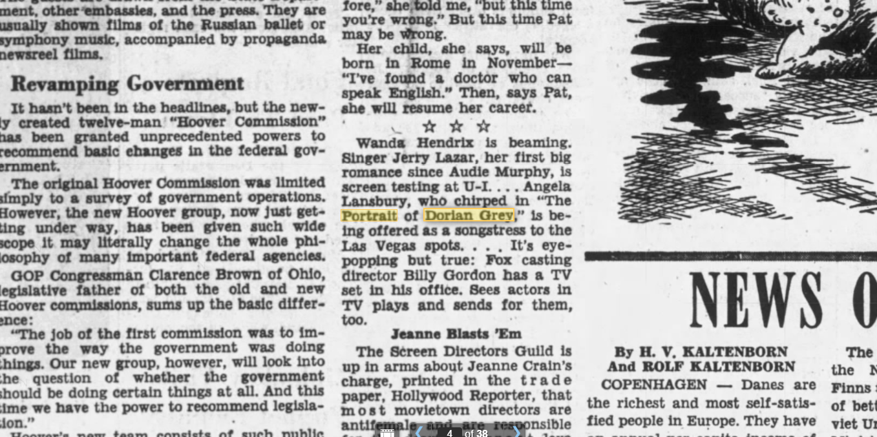

Slide 72
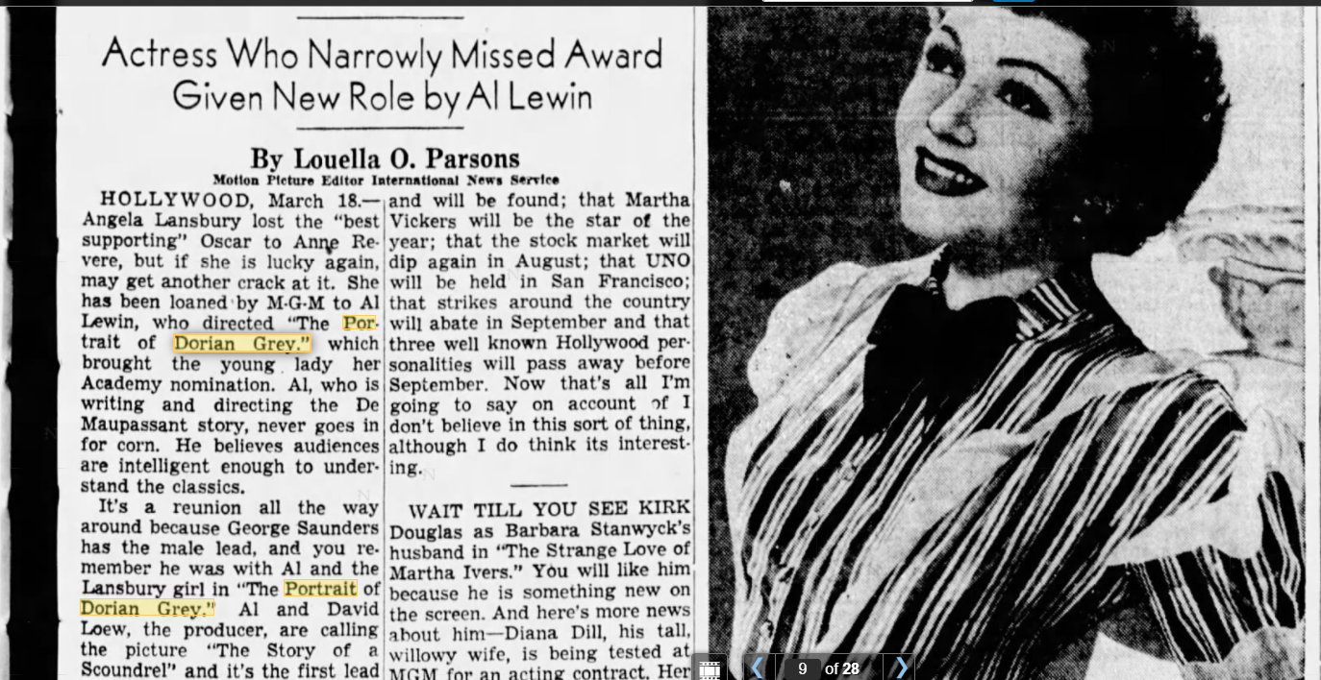

Slide 73
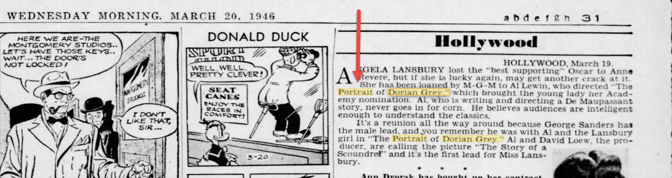

Slide 74
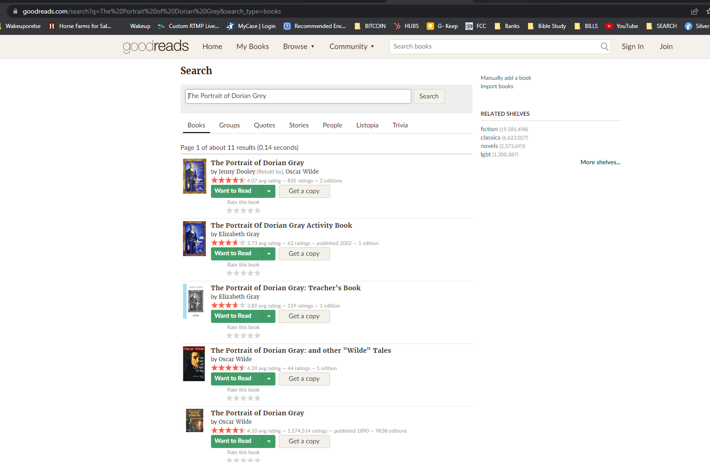

Slide 75
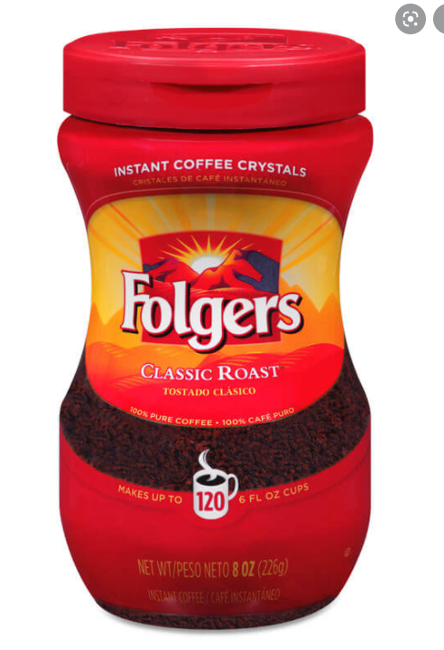
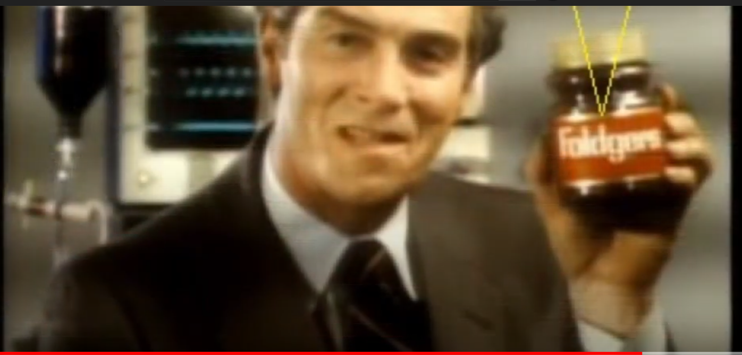
Folgers or Foldger’s

Slide 76
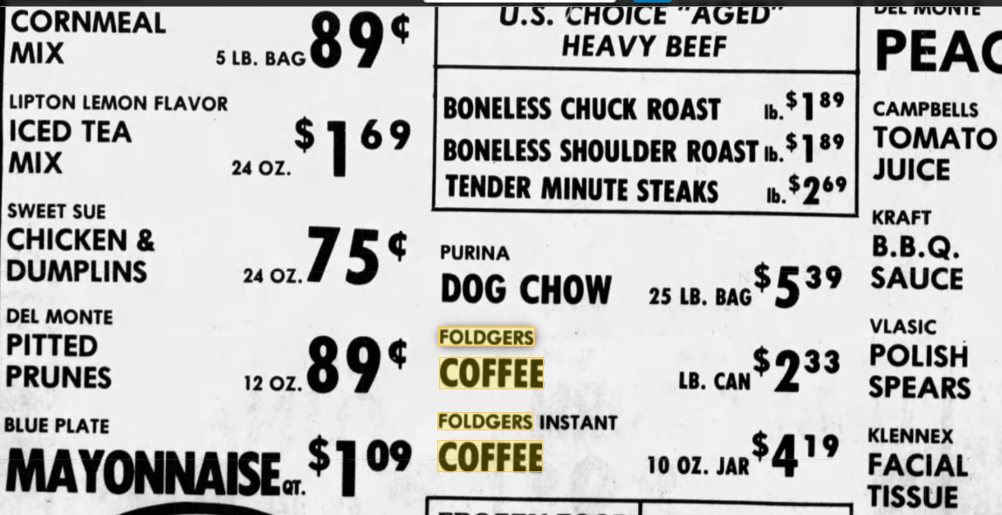

Slide 77
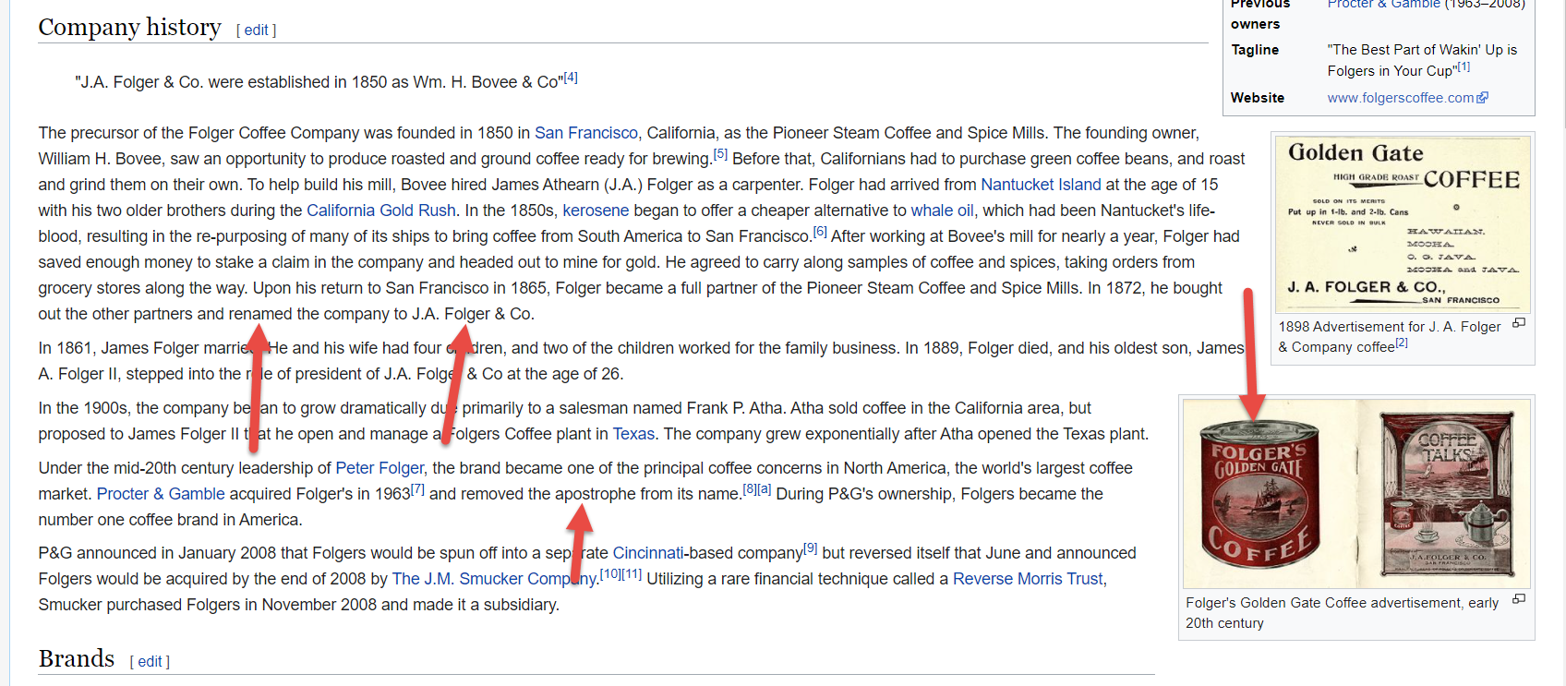

Slide 78
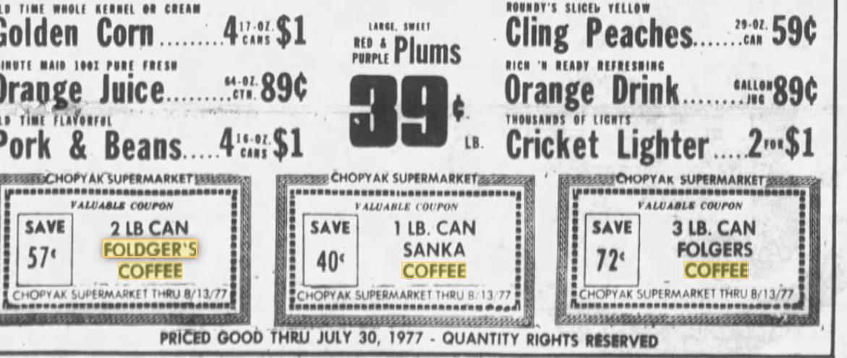

Slide 79
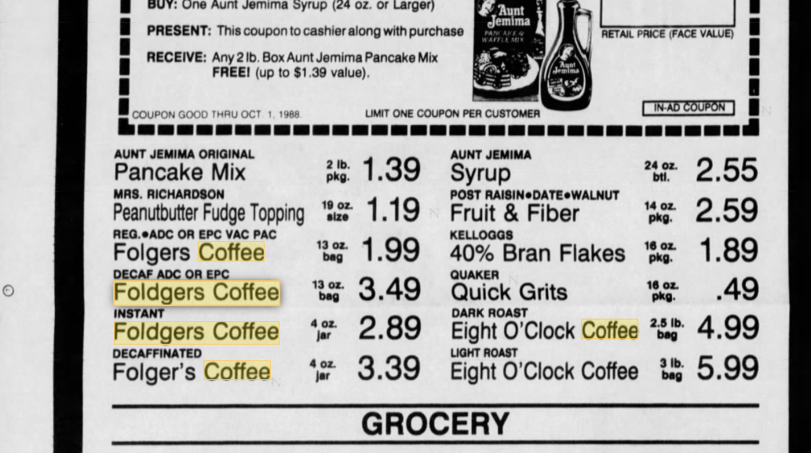

Slide 80

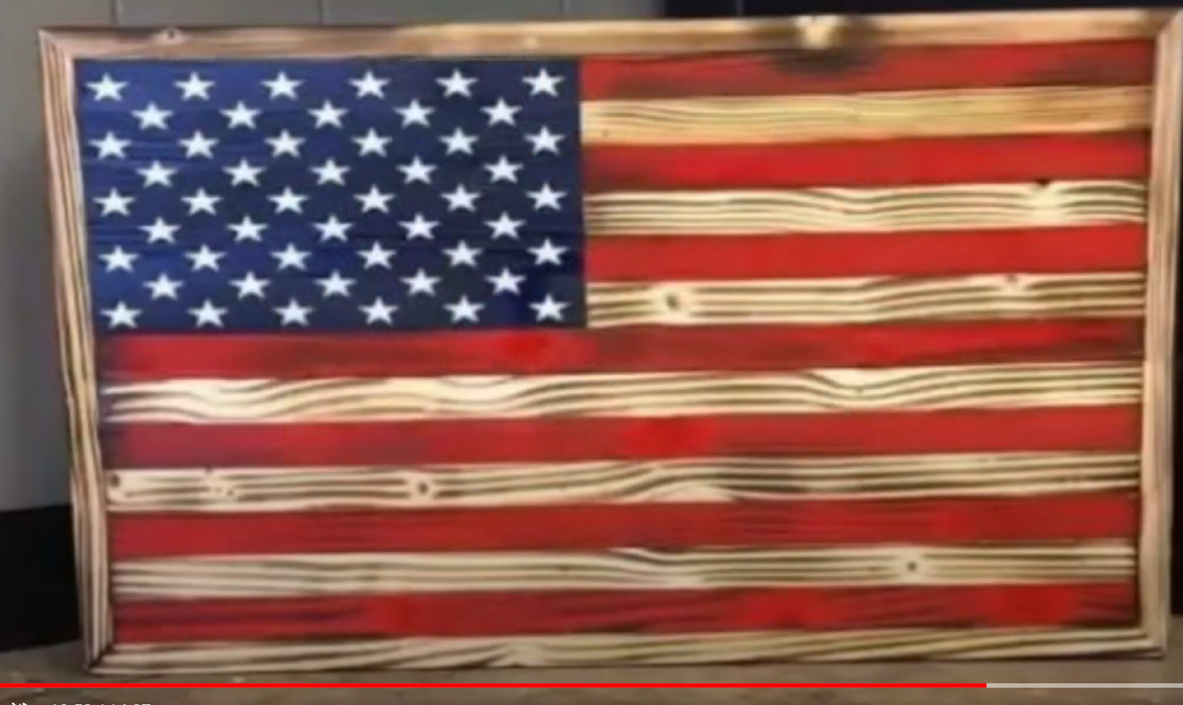

Slide 81
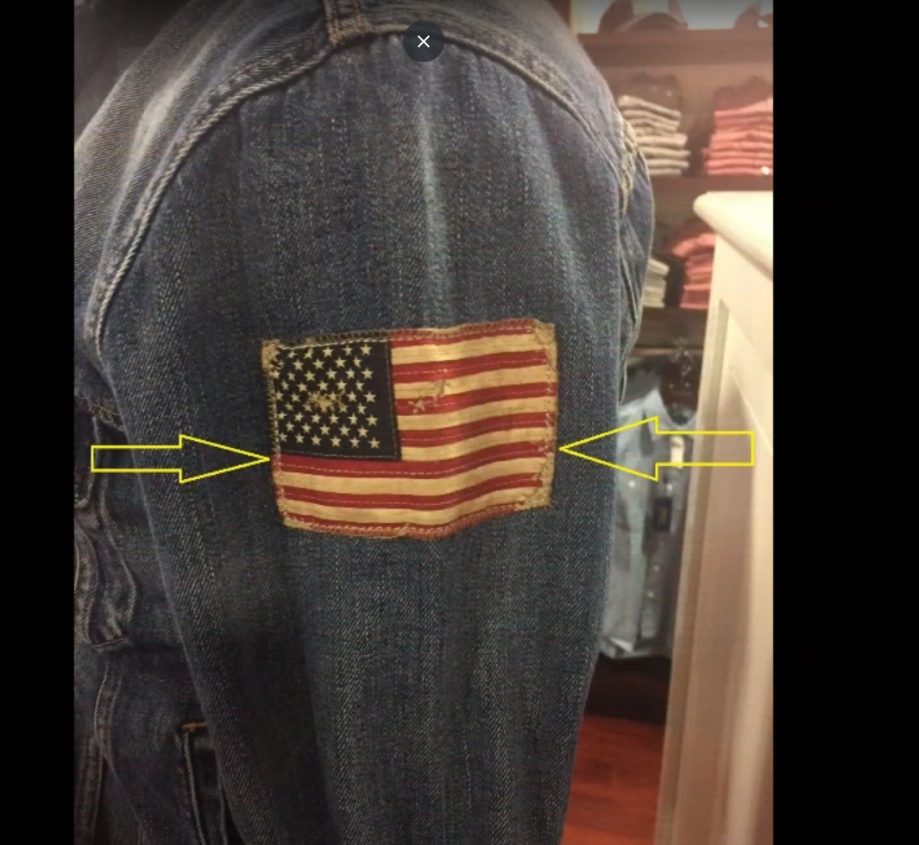

Slide 82
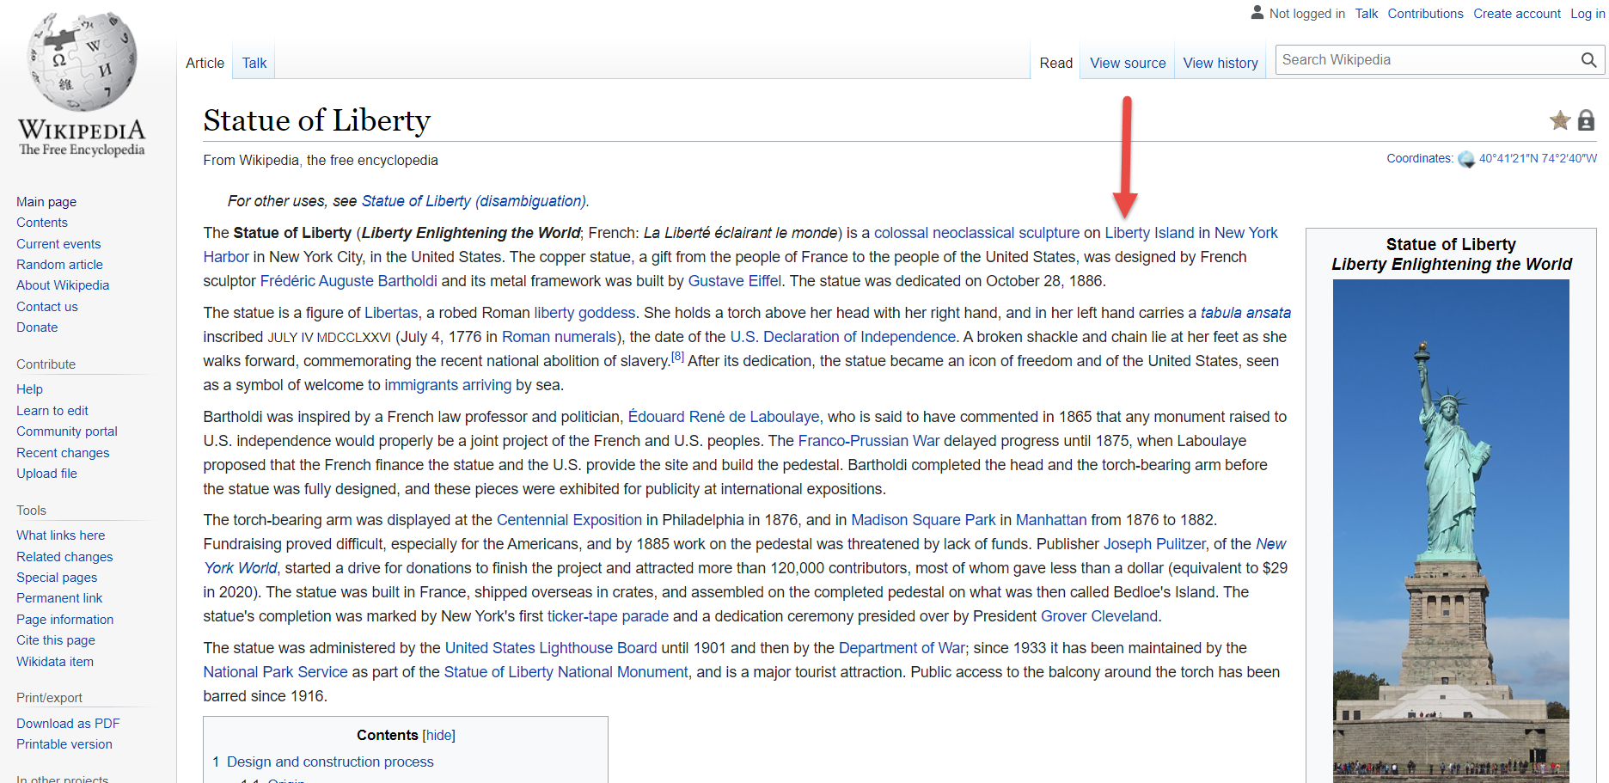

Slide 83
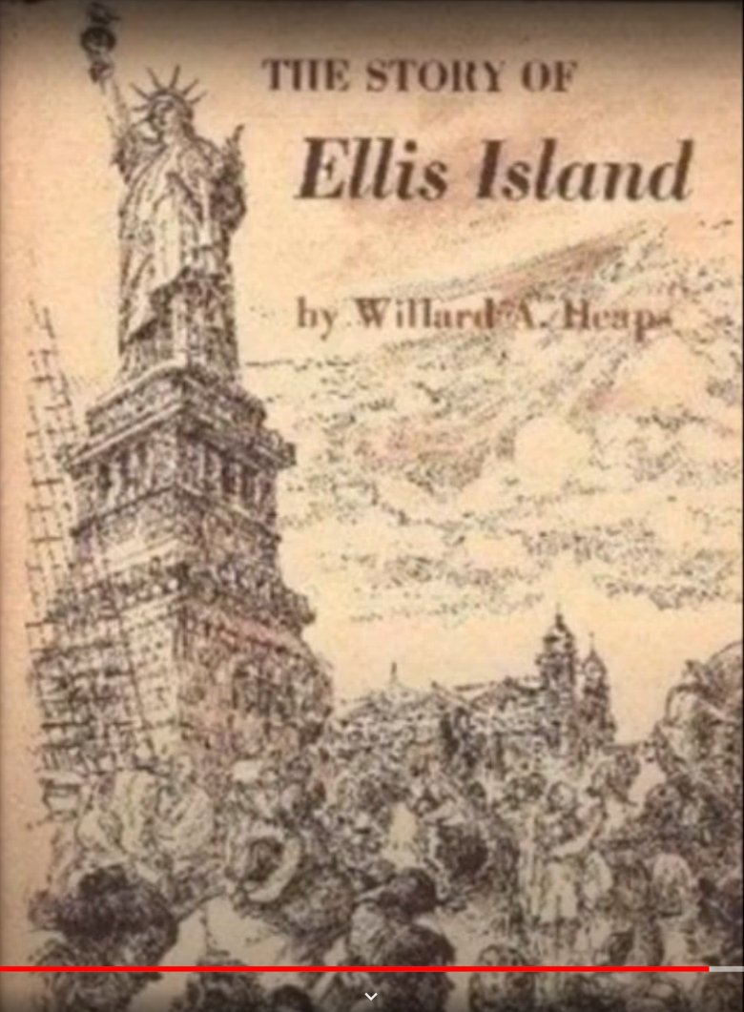
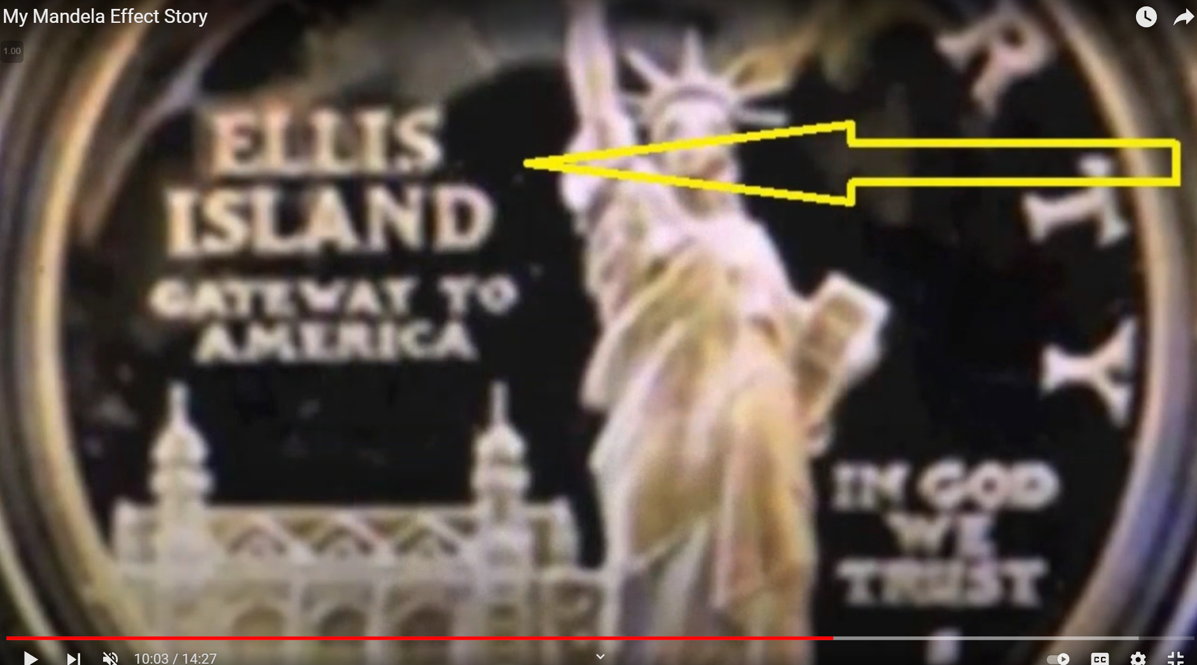
Ellis

Slide 84
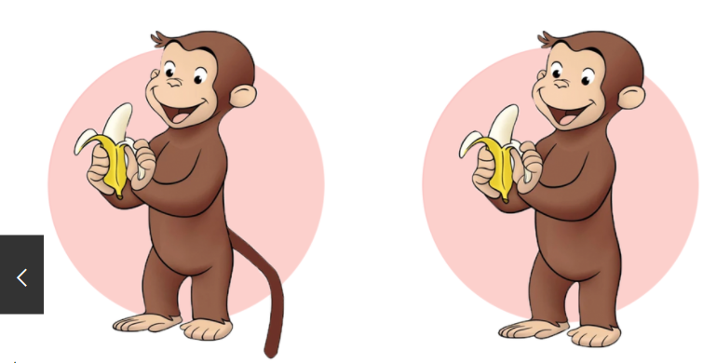

Slide 85


Slide 86
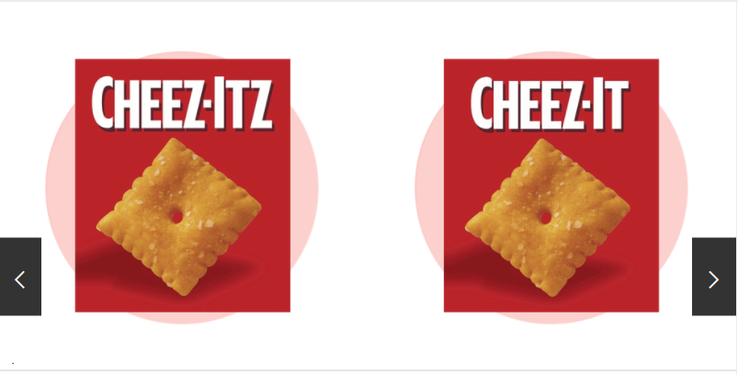

Slide 87
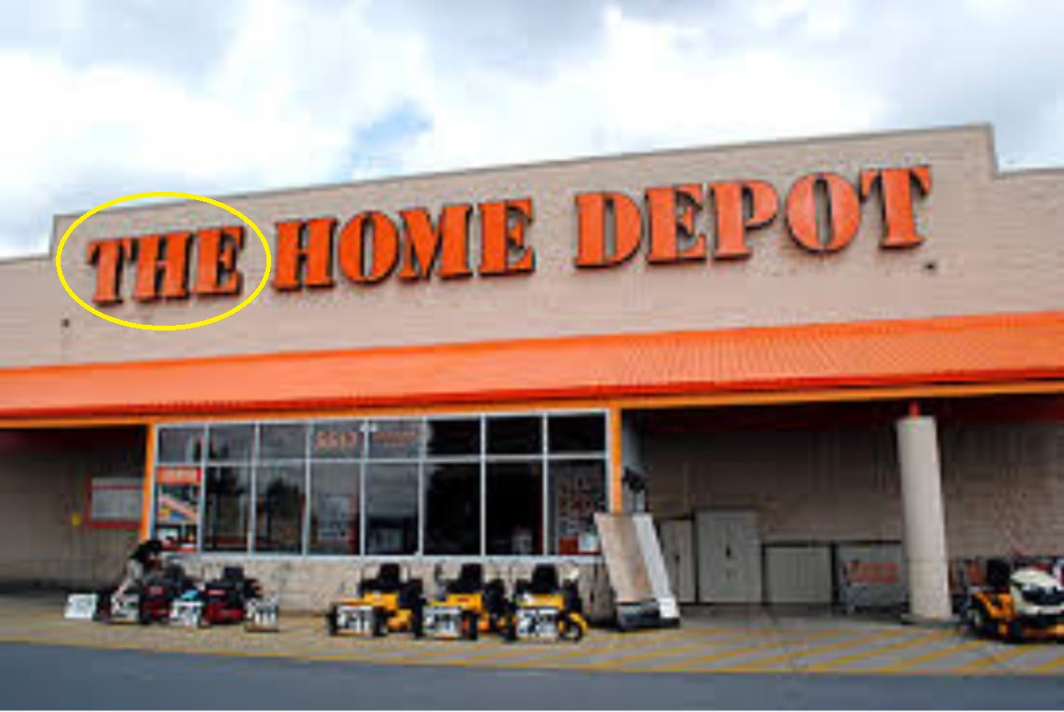
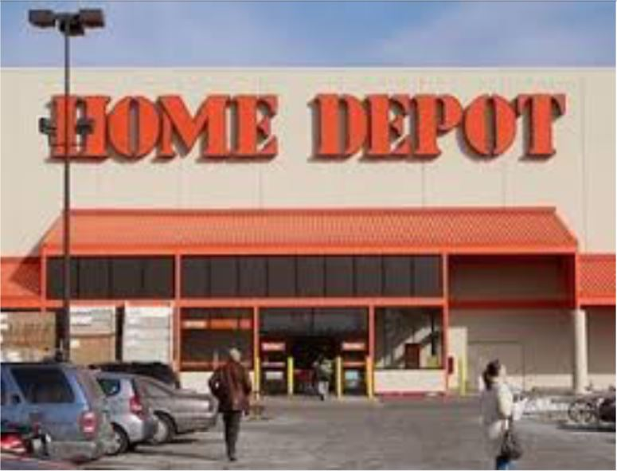

Slide 88
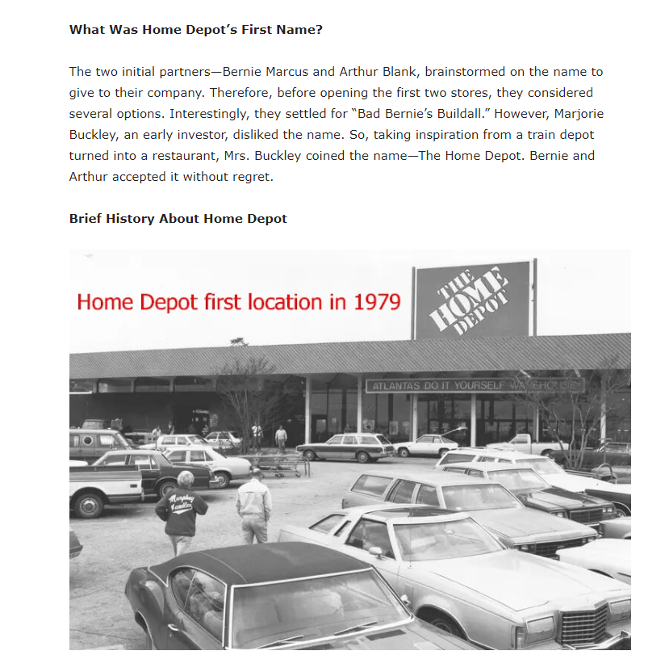
The Home Depot

Slide 89
Flip Flops
Huston we have a problem
Tidy Kats
Chuck E Cheese
Flintstones

Slide 90

Chuck e __________

Slide 91

Which is it? Its Flip Flopping

Slide 92

As of 3/12/2022

Slide 93
Chuck e cheese (Wikipedia timeline)
1994
  The name was shortened to Chuck E. Cheese’s
2019
  The name was shortened again to Chuck E. Cheese

Slide 94

From 2/18/2020

Slide 95

File date is 2/2020

Slide 96
CEB, EXB Versions
On that day, the Lord will shave with a razor hired from beyond the Euphrates—with the king of Assyria—the head and the pubic hair, and will cut off the beard as well

Slide 97


Slide 98


Slide 99


Slide 100


Slide 101
CEB, EXB Versions
On that day, the Lord will shave with a razor hired from beyond the Euphrates—with the king of Assyria—the head (Female Genitals) and the pubic hair, and will cut off the beard as well

Slide 102
Isaiah 27:12 NAS Version
And it shall come to pass in that day, that Jehovah will beat off his fruit from the flood of the River unto the brook of Egypt; and ye shall be gathered one by one, O ye children of Israel.

Slide 103
Nursing Fathers? LBGT adgenda
Num 11:12 Have I conceived all this people? have I begotten them, that thou shouldest say unto me, Carry them in thy bosom, as a nursing father beareth the sucking child, unto the land which thou swarest unto their fathers?
Isaiha 60:16 Thou shalt also suck the milk of the Gentiles, and shalt suck the breast of kings: and thou shalt know that I the LORD am thy Saviour and thy Redeemer, the mighty One of Jacob.

Slide 104
Female Angels?
Zechariah 5:9.
  Then lifted I up mine eyes, and looked, and, behold, there came out two women, and the wind was in their wings; for they had wings like the wings of a stork: and they lifted up the ephah between the earth and the heaven.

Slide 105
Vulgar
How many times the bible use the term pisseth against a wall
  ANSWER 6
  1st Samuel 25:22, 1st Samuel 25:30, 1st Kings 16:11, 1st Kings 14:10, 1st Kings 21:21 2nd Kings 9:8
Isaiah 36:12
  But Rabshakeh said, Hath my master sent me to thy master and to thee to speak these words? hath he not sent me to the men that sit upon the wall, that they may eat their own dung, and drink their own piss with you?

Slide 106
Fairy tales
How many times does the bible mention unicorns
  ANSWER 9
Numbers 23:22, Numbers 24:8, Deuteronomy 33:17, Job 39:9, Job 39:10, Psalms 22 20, Psalms 29:6, Psalms 92:10, Isaiah 34:7

Slide 107
New places
Num 33:46 Almondiblathaim.
Num 33:16 Kibrothhattaavah.
Josh 18:24 Chepharhaammonai
1 Sam 1:1 Ramathaimzophim
1 Sam 23:28 Selahammahlekoth
2 Sam 2:16 Helkathhazzurim
2 Kgs 15:29 Abelbethmaachah
2 Kgs 15:29 Abelbethmaachah

Slide 108
New names
Judges 3:8 King Chushanrishathaim
2 Kgs 20:12 Berodachbaladan
Isa 8:1 Mahershalalhashbaz.
  (Illegitimate child of Isaiah)
Ezra 4:9 Apharsathchites People group
Isa 39:1 Merodachbaladan

Slide 109
Isaiah 8:1-3 NIV
The Lord said to me, “Take a large scroll and write on it with an ordinary pen: Maher-Shalal-Hash-Baz.” So I called in Uriah the priest and Zechariah son of Jeberekiah as reliable witnesses for me. Then I made love to the prophetess, and she conceived and gave birth to a son. And the Lord said to me, “Name him Maher-Shalal-Hash-Baz

Slide 110


Slide 111
Islam agenda Luke 19:27
“But those mine enemies, which would not that I should reign over them, bring hither, and slay them before me. Should be show them before me

Slide 112
Does god condone sin now
Hos 4:14
  I will not punish your daughters when they commit whoredom, nor your spouses when they commit adultery: for themselves are separated with whores, and they sacrifice with harlots: therefore the people that doth not understand shall fall.
2 Cor 11:8
  I robbed other churches taking wages of them to do you service
Prov 26:10
  The great God that formed all things both rewardeth the fool, and rewardeth transgressors.

Slide 113
Perversion will proliferate
Ezekiel 23:20
  There she lusted after her lovers, whose genitals were like those of donkeys and whose emission was like that of horses.
Luke 17:34
  I tell you, in that night there shall be two men in one bed; the one shall be taken, and the other shall be left. Two women will be grinding grain together: One will be taken and the other left.

Slide 114


